Slide 1
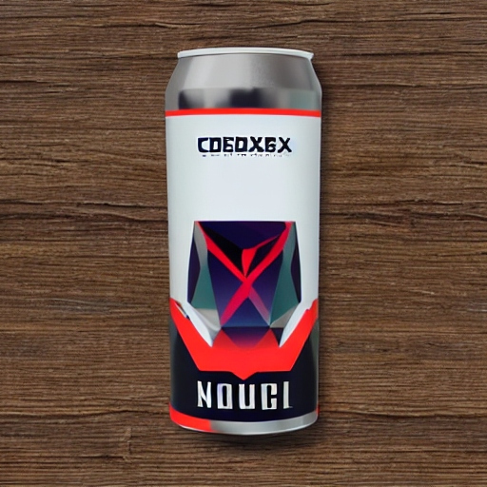
Codex Drink Marketing Analysis Report

Slide 2
Codex marketing Analysis Report
Codex is a German beverage company that is aiming to make its mark in the Indian market. A few months ago, they launched their energy drink in 10 cities in India.
Their Marketing team is responsible for increasing brand awareness, market share, and product development. They conducted a survey in those 10 cities and received results from 10k respondents. Peter Pandey, a marketing data analyst is tasked to convert these survey results to meaningful insights which the team can use to drive actions.

Slide 3

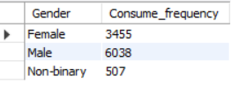
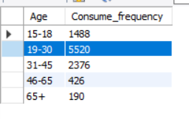
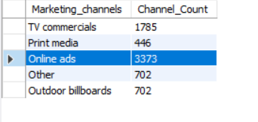
Codex marketing Analysis Report
a.Who prefers energy drink more?
Male
b.which age group prefers energy drinks more?
19-30
c.Which type of marketing reaches the most Youth (15-30)?
Online ads

Slide 4
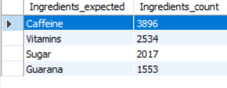
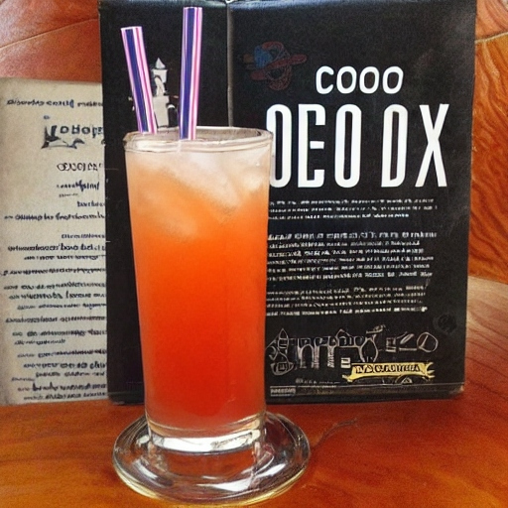
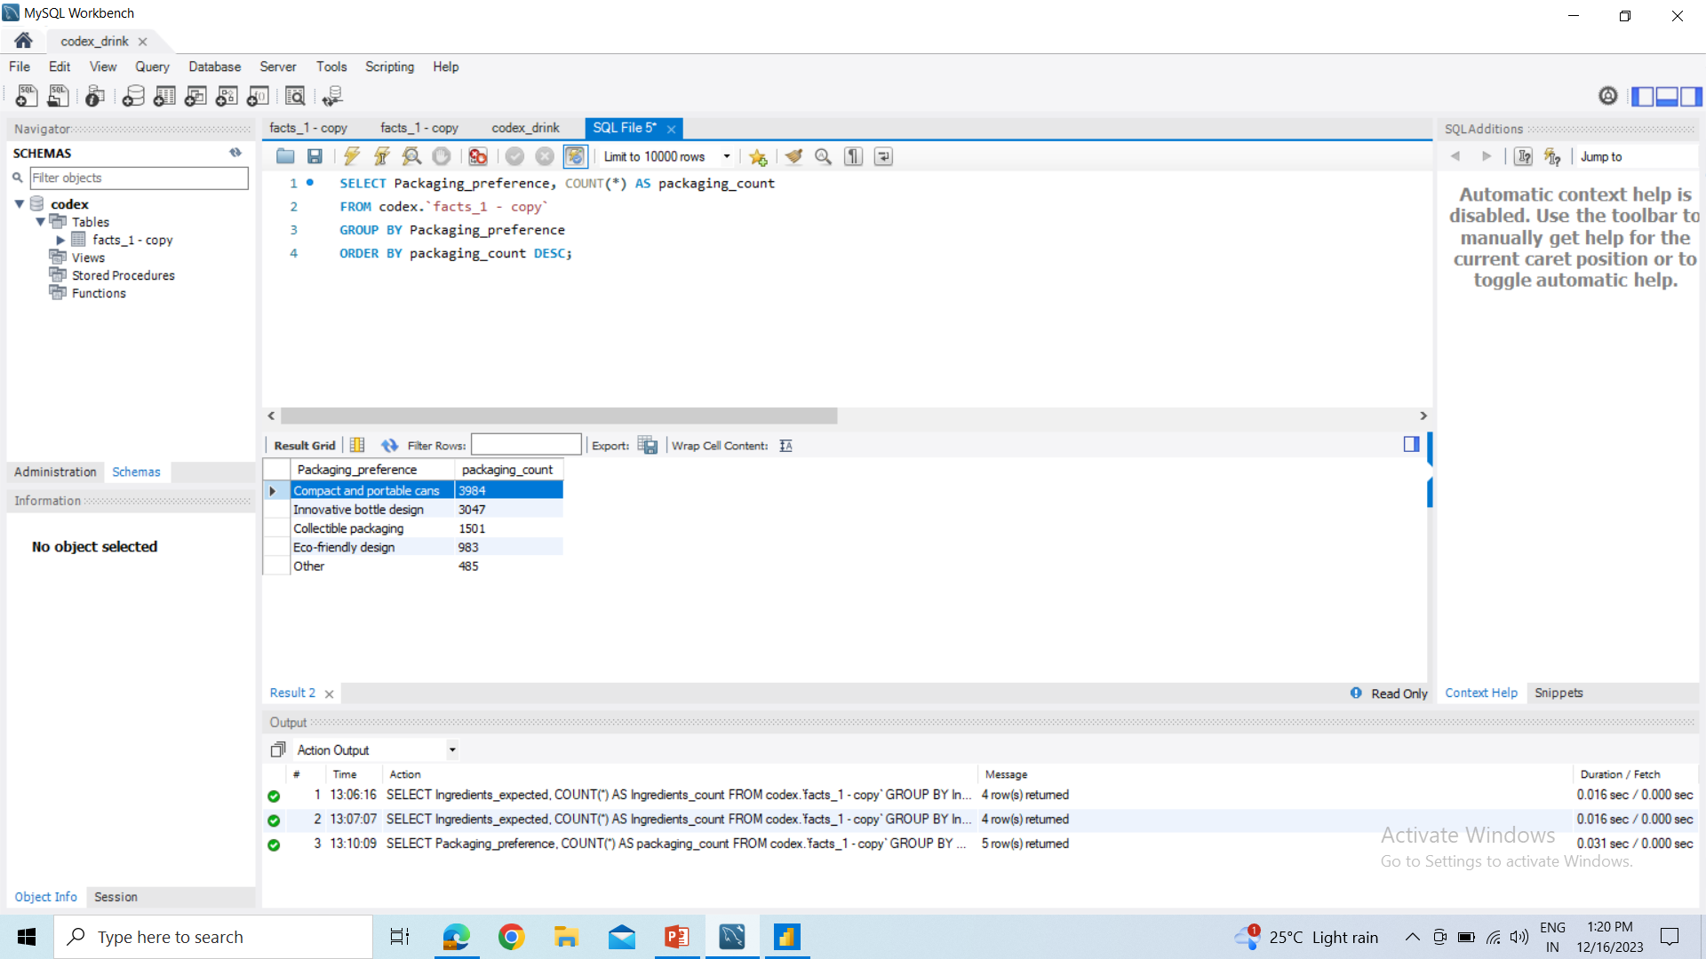
Codex marketing Analysis Report
a.What are the preferred ingredients of energy drinks among respondents?
Caffeine
b. What packaging preferences do respondents have for energy drinks?
Compact and portable cans

Slide 5
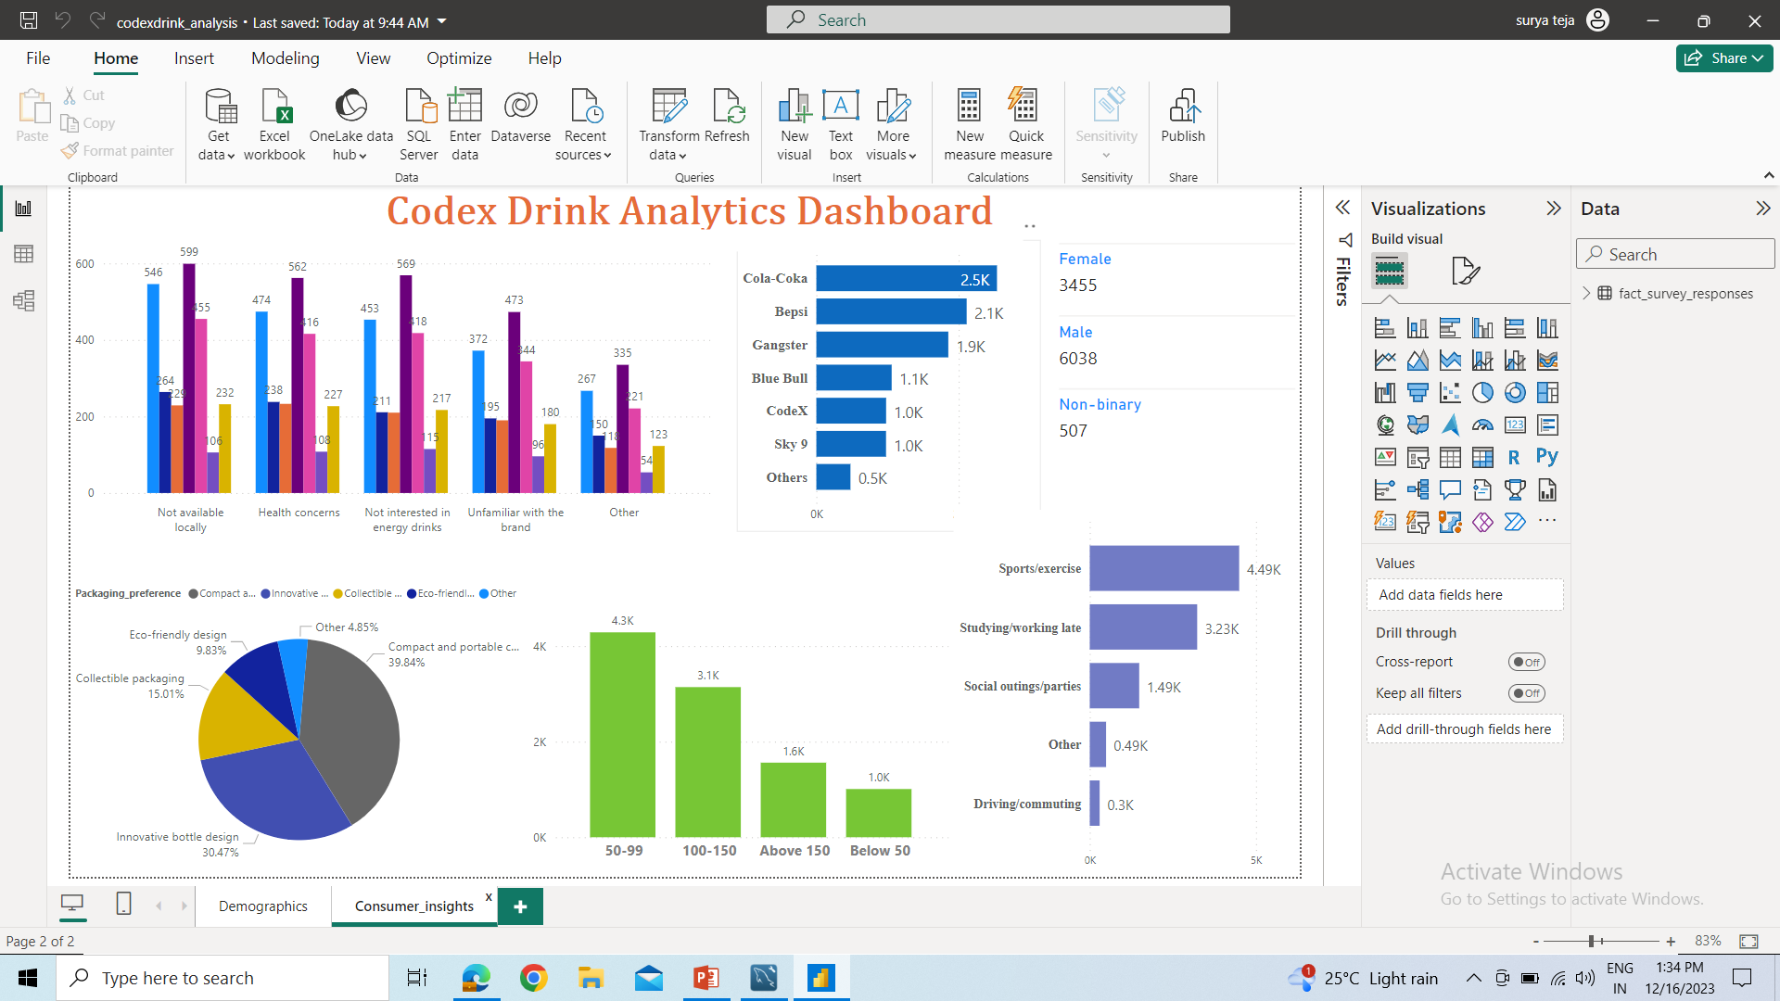
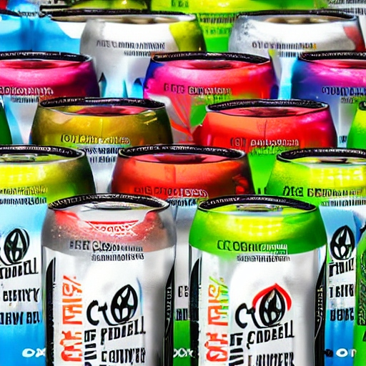
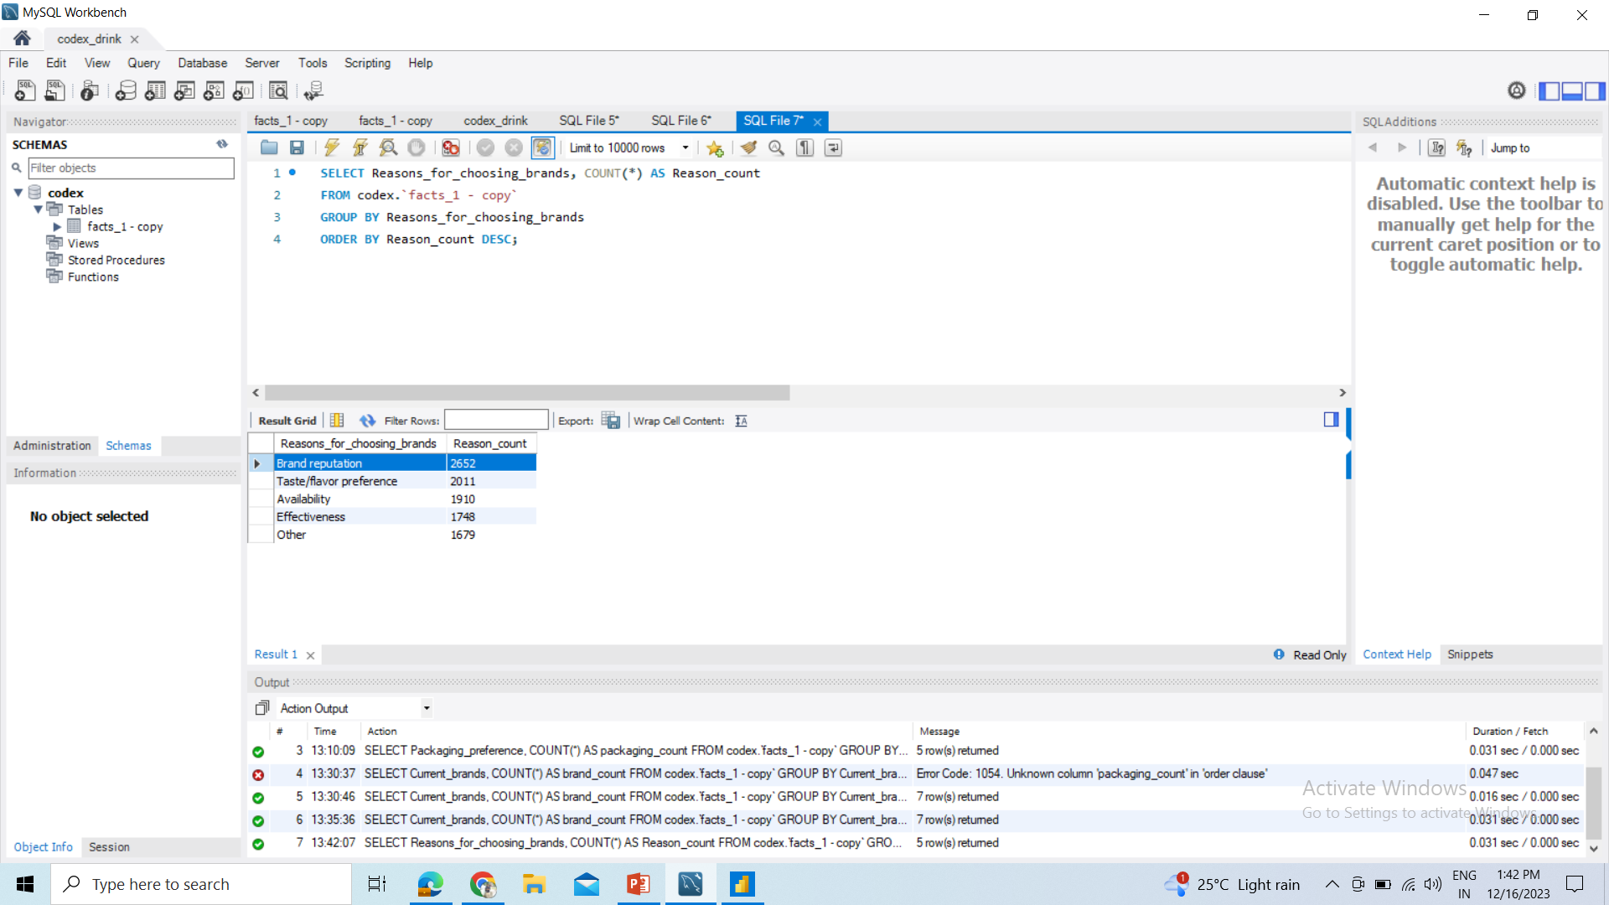
Codex marketing Analysis Report
a.Who are the current market leaders?
Cola-coka
b.What are the primary reasons consumers prefer those brands over ours?
Brand reputation

Slide 6
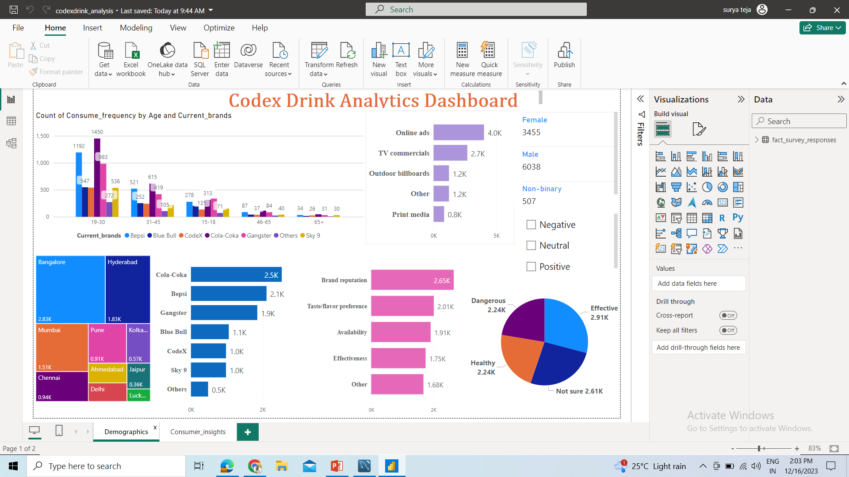
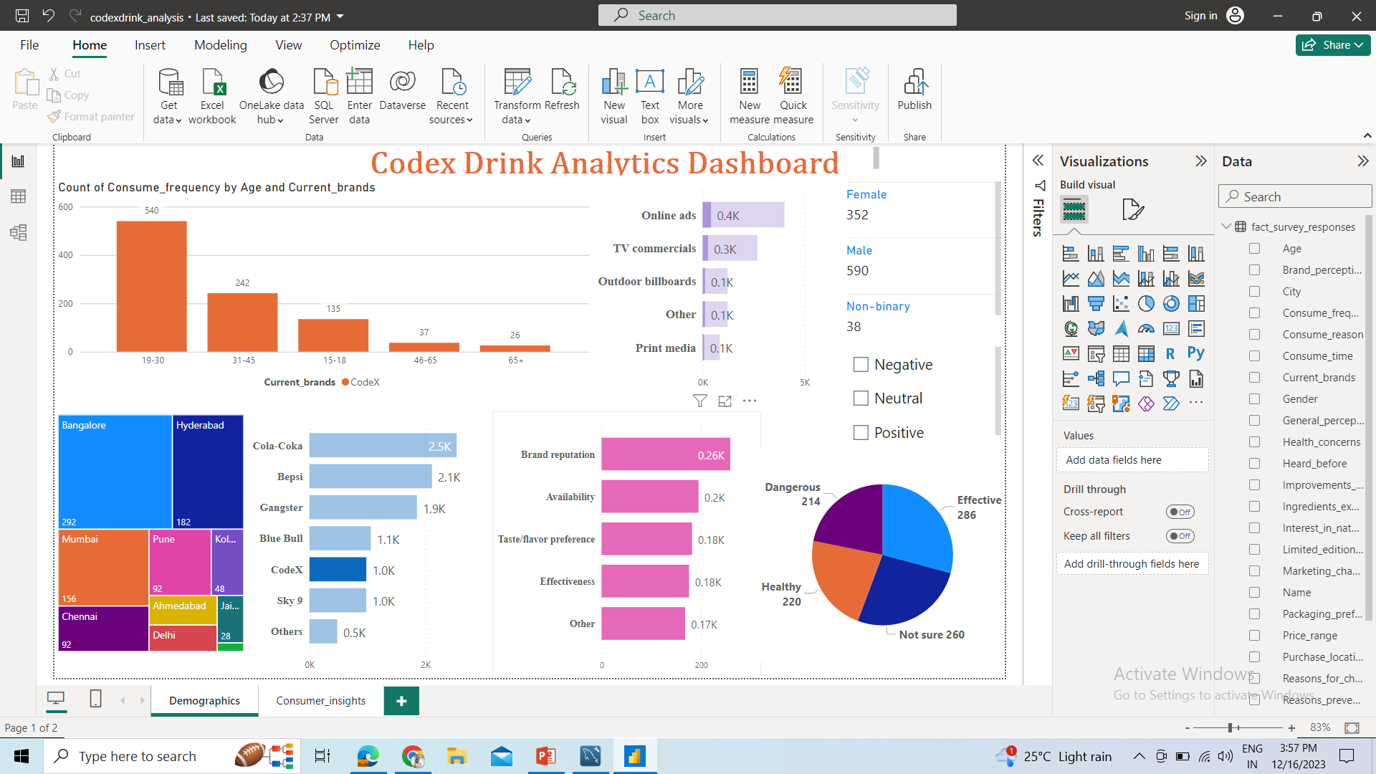
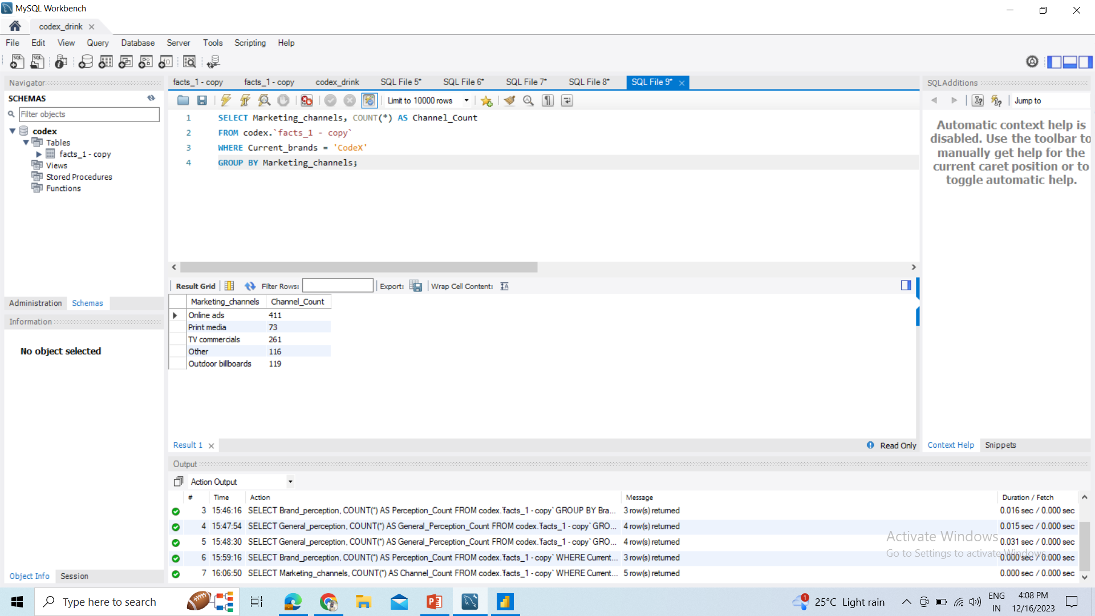
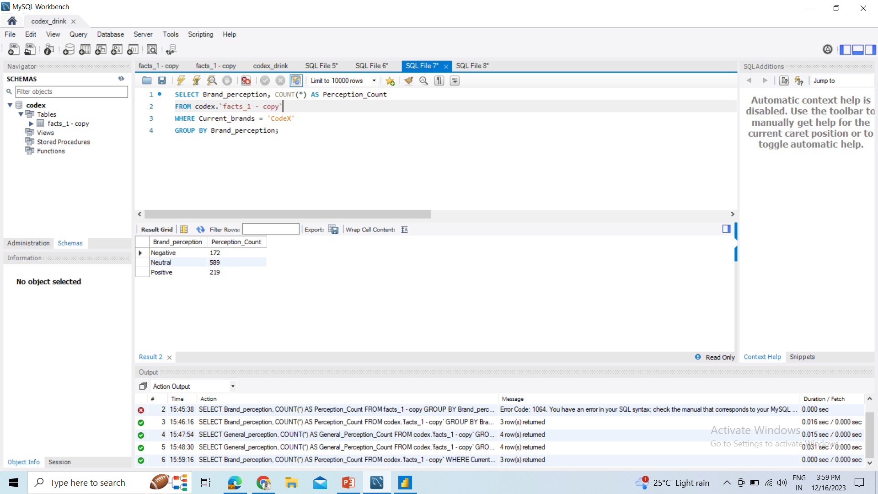

Codex marketing Analysis Report
a.Which marketing channel can be used to reach more customers?
Online ads
b. How effective are different marketing strategies and channels in reaching our customers?
From customer response analysis and marketing analysis. We can say they are effective to improve our outcomes.

Slide 7
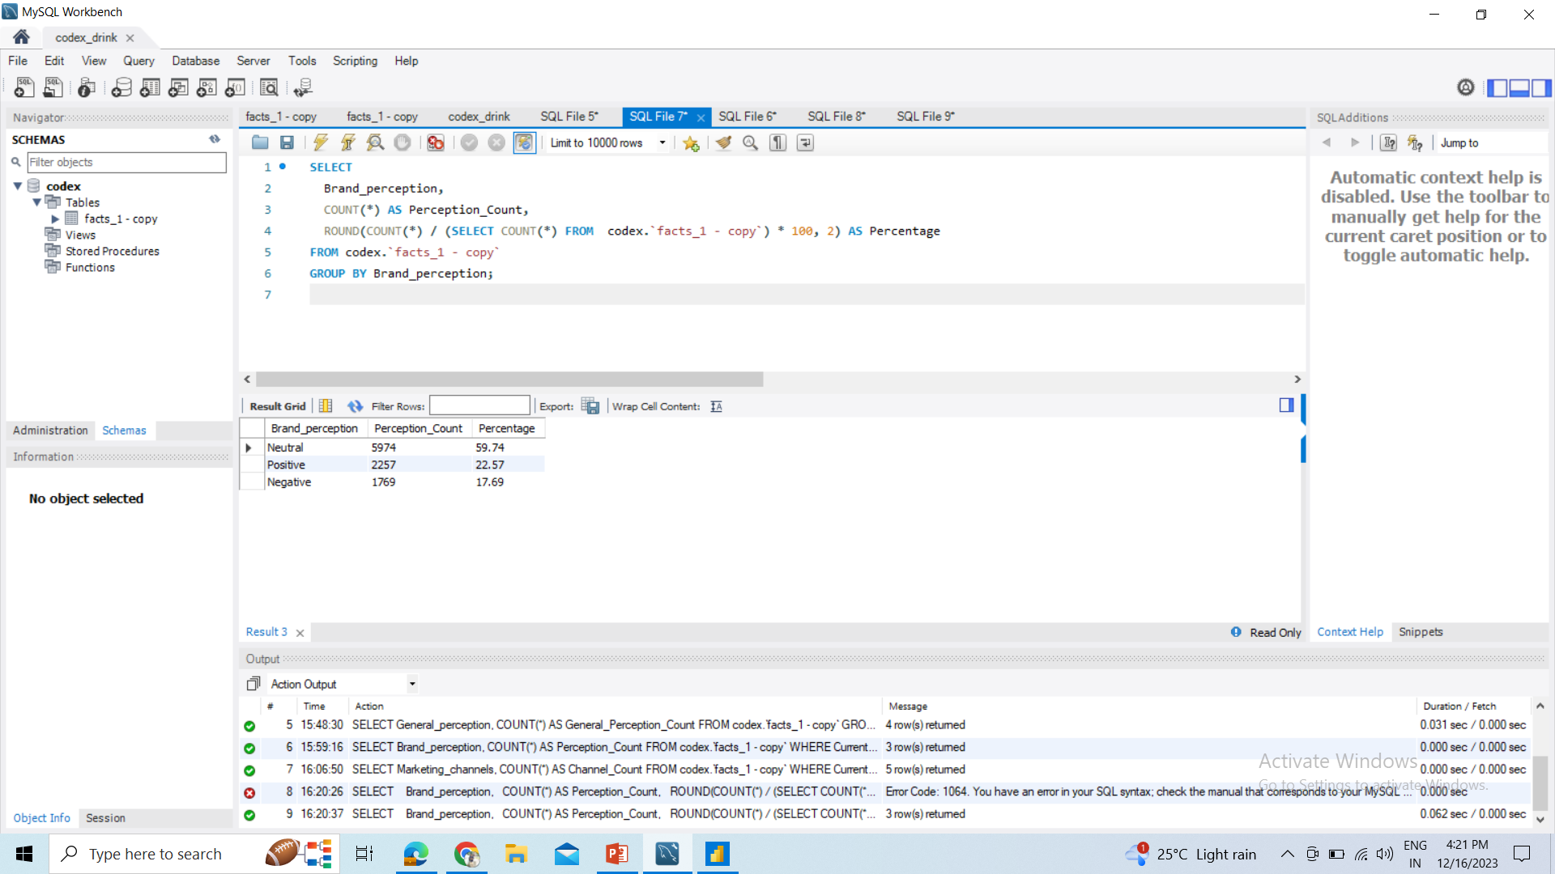
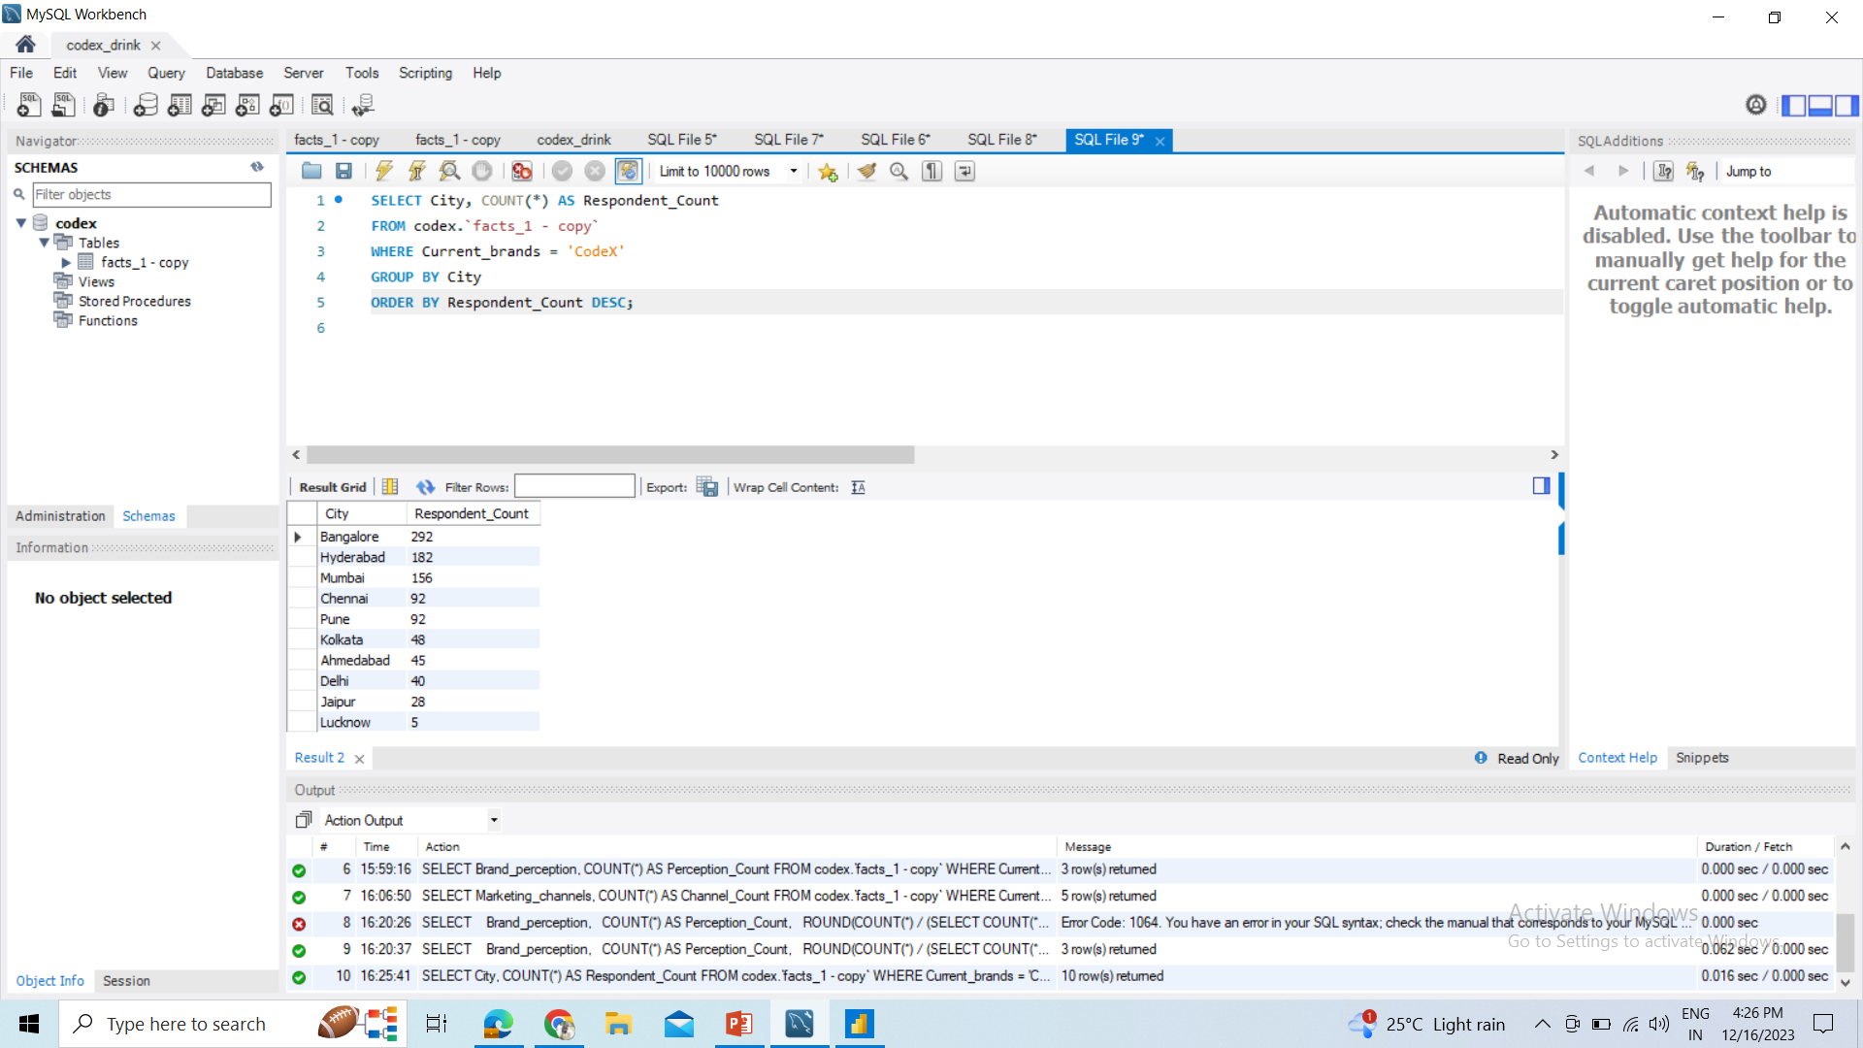
Codex marketing Analysis Report
a.What do people think about our brand? (overall rating)
0.6076
b. Which cities do we need to focus more on?
From dataset given we need to focus on Delhi, Jaipur and Lucknow

Slide 8
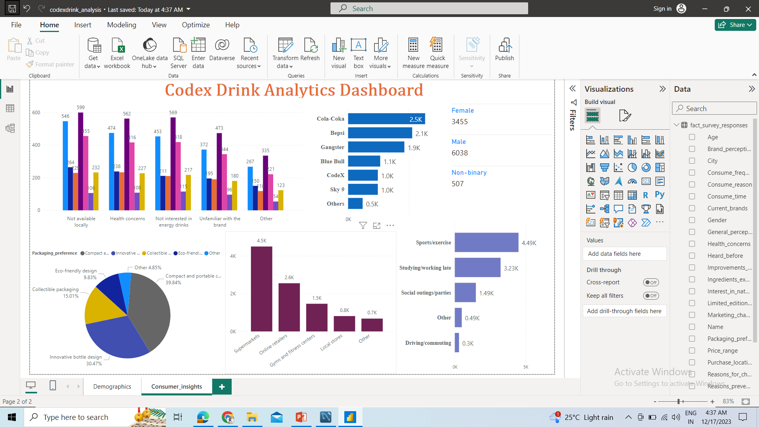
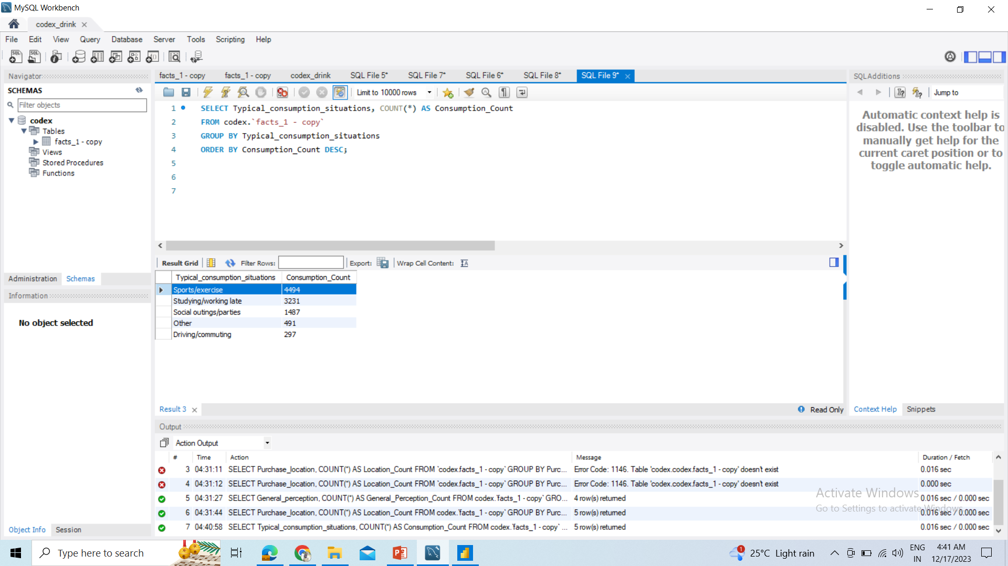
Codex marketing Analysis Report
a.Where do respondents prefer to purchase energy drinks?
supermarkets
b.What are the typical consumption situations for energy drinks among respondents?
Sports/exercise

Slide 9
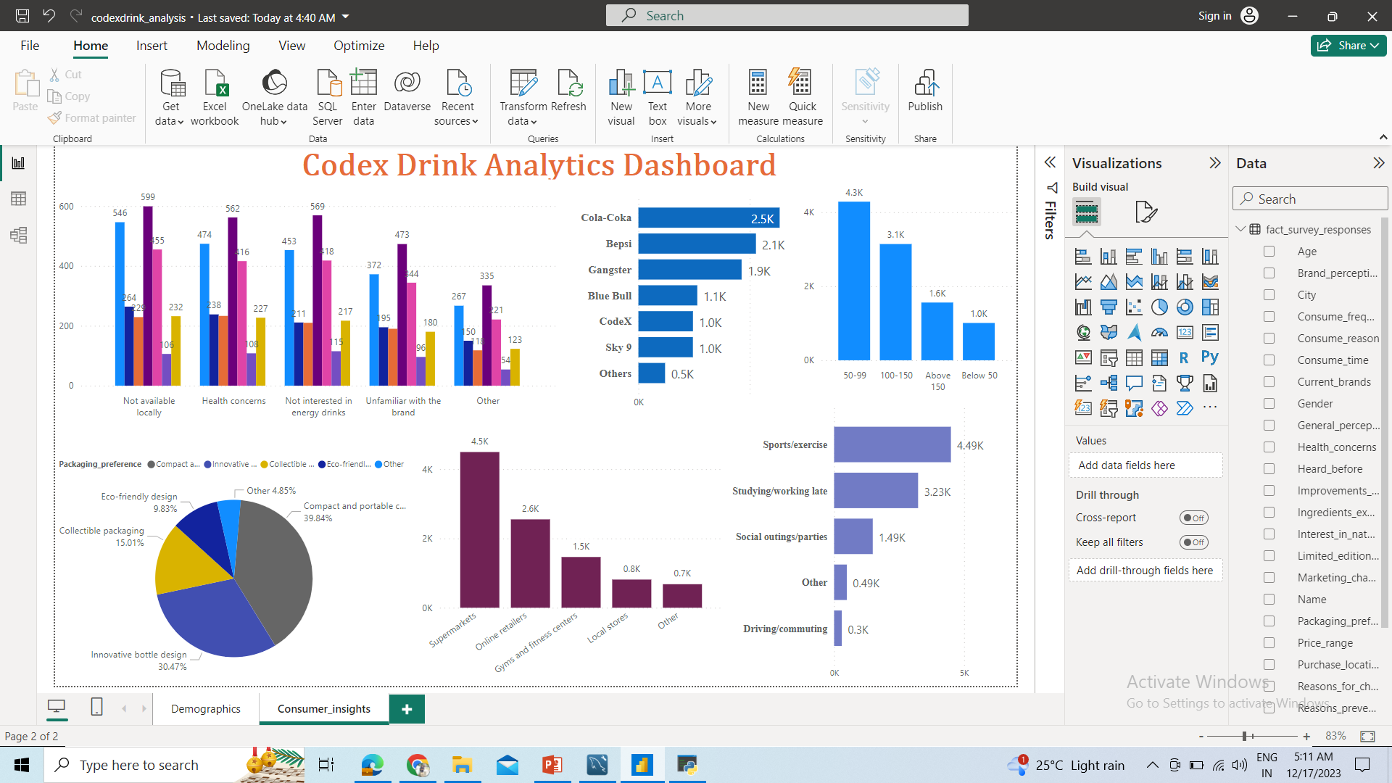
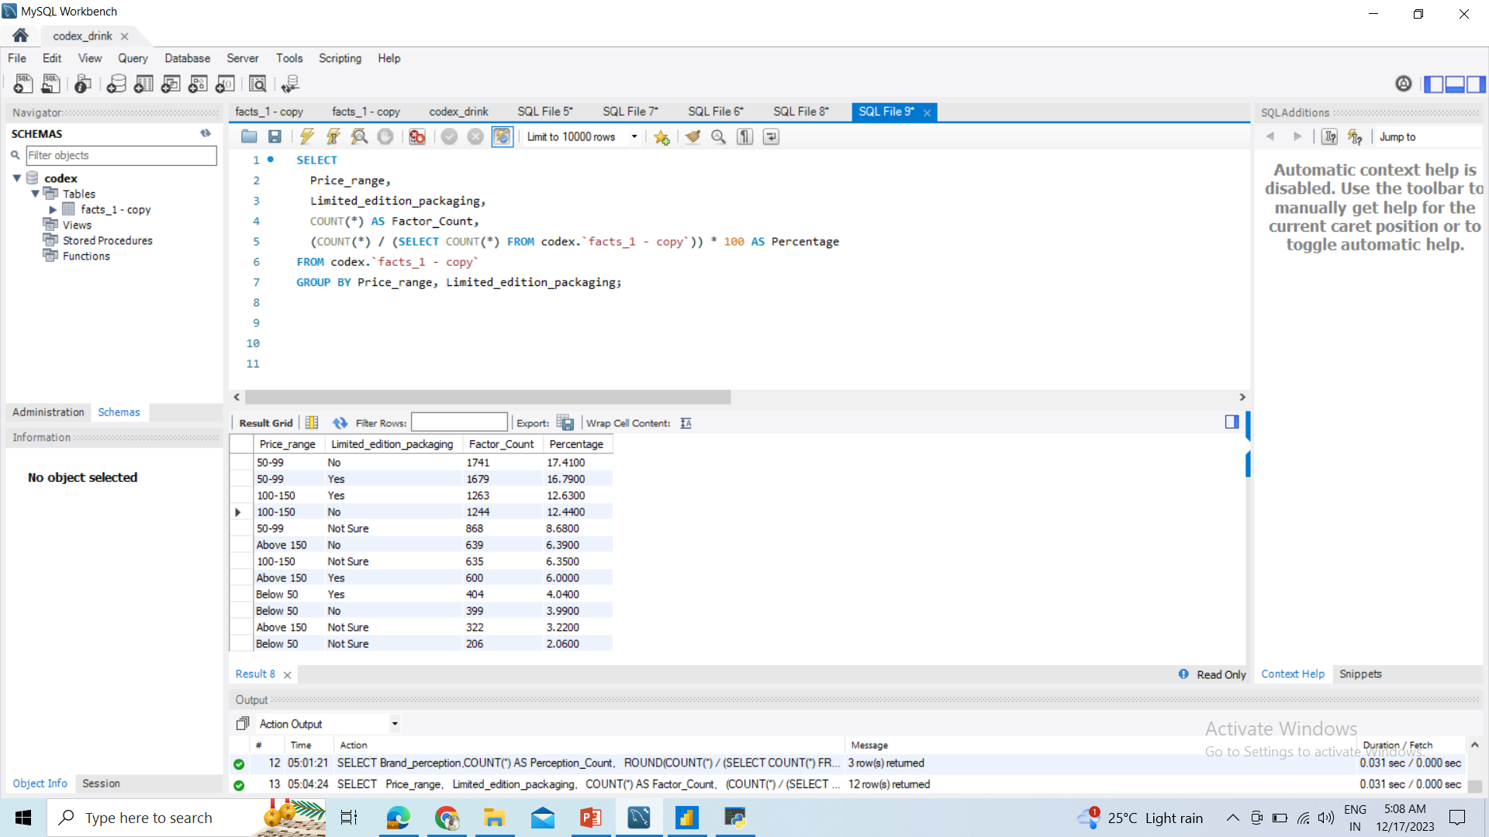
Codex marketing Analysis Report
c. What factors influence respondents' purchase decisions, such as price range and limited edition packaging?
We can say from table Price range influence respondents more. Limited edition packaging contribute 16%.

Slide 10
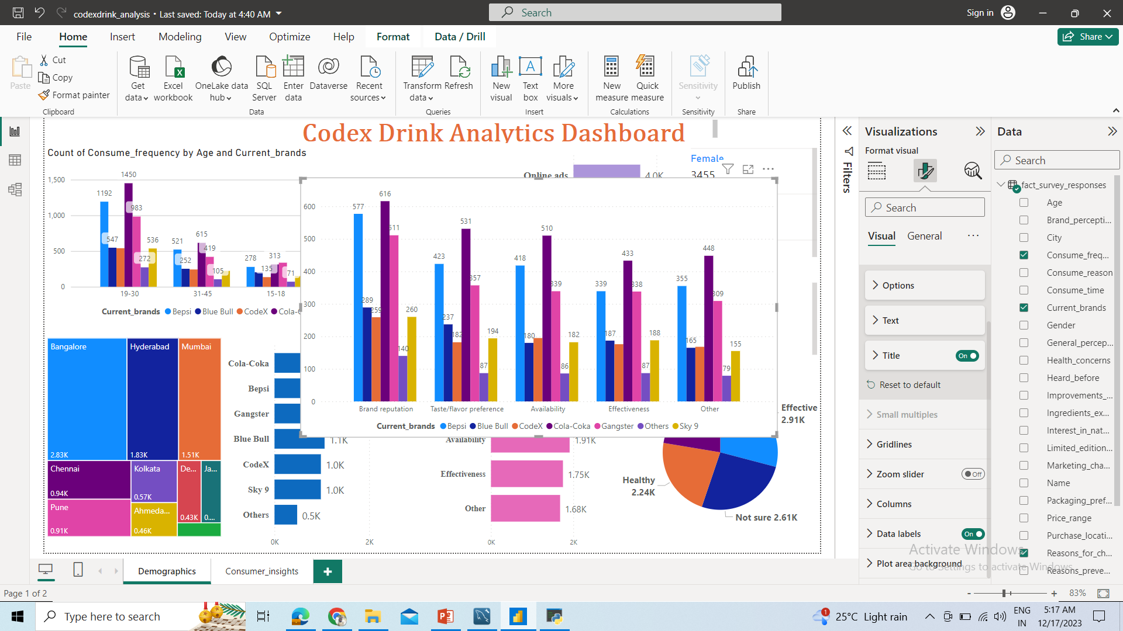
Codex marketing Analysis Report
Which area of business should we focus more on our product development? (Branding/taste/availability)
we have to focus more on Branding and Availability.

Slide 11
Codex marketing Analysis Report
What immediate improvements can we bring to the product?
We have to increase the Availabity and brand reputation
What should be the ideal price of our product?
50-99
What kind of marketing campaigns, offers, and discounts we can run?
We Can give free samples in malls, markets.
5 -8 percent discount.
Run contests on social media platforms with
the chance to win discounts or free products.
I suggest cricket player like virat-kohli, Dhoni.
Who can be a brand ambassador, and why?
Who should be our target audience, and why?
19-30 years people are our target audience.

